Slide 1
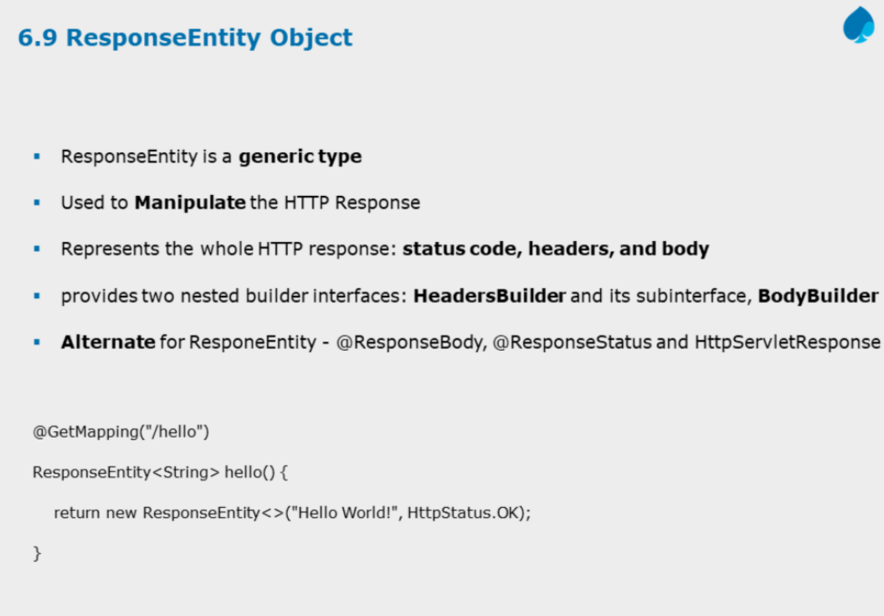

Slide 2
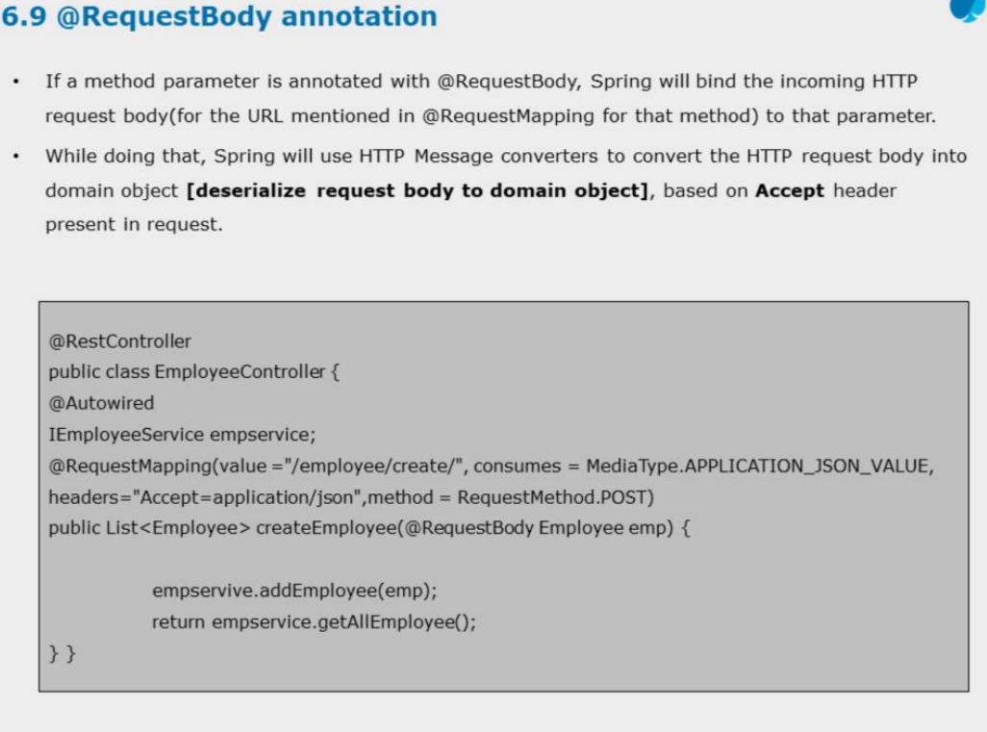

Slide 3
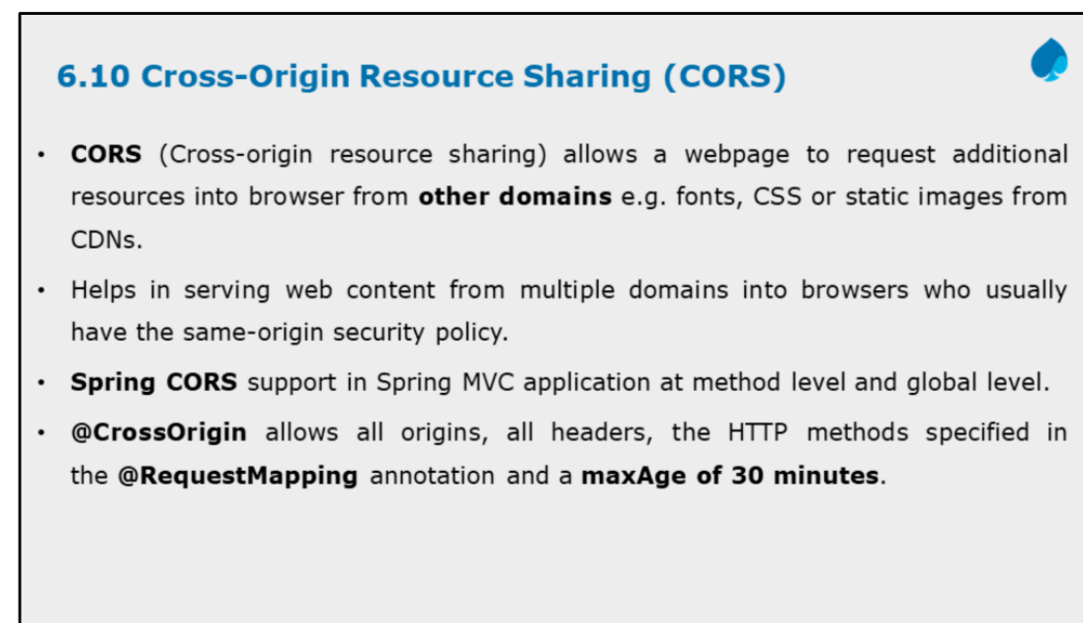

Slide 4
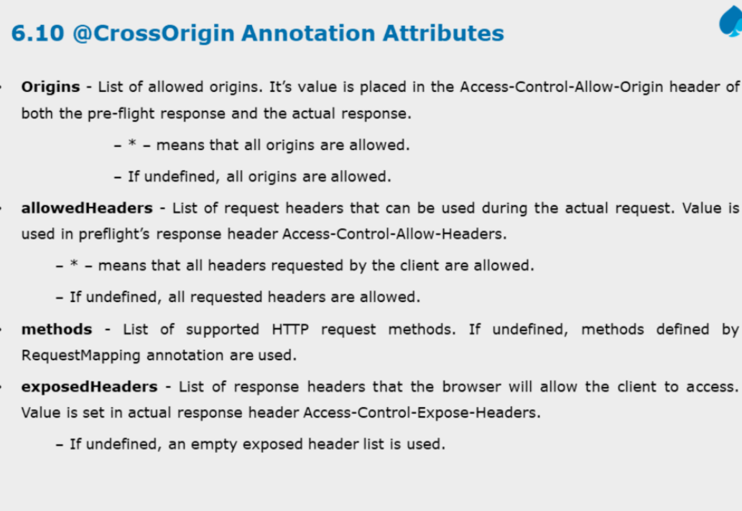

Slide 5
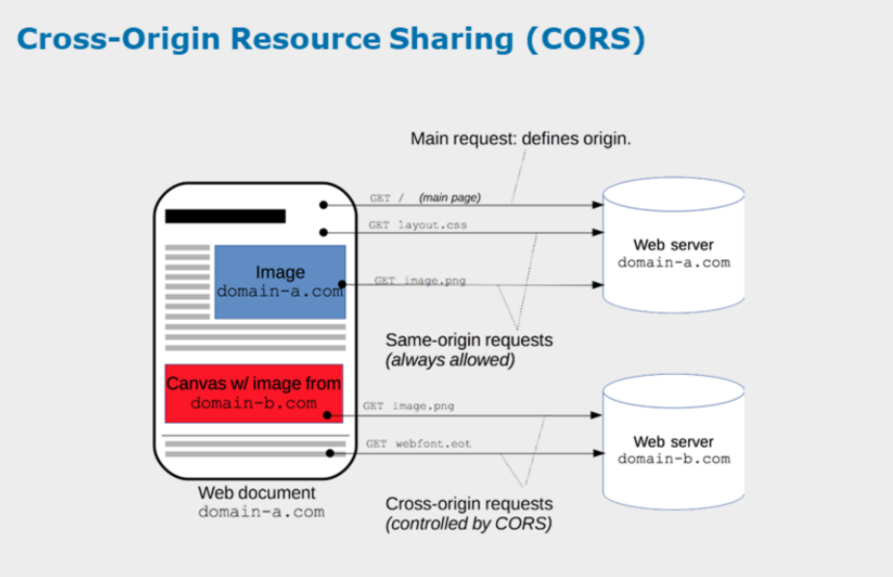
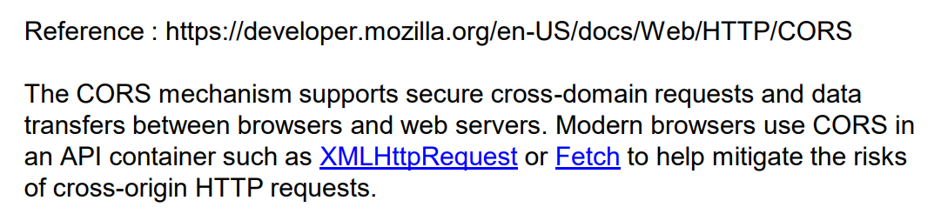

Slide 6
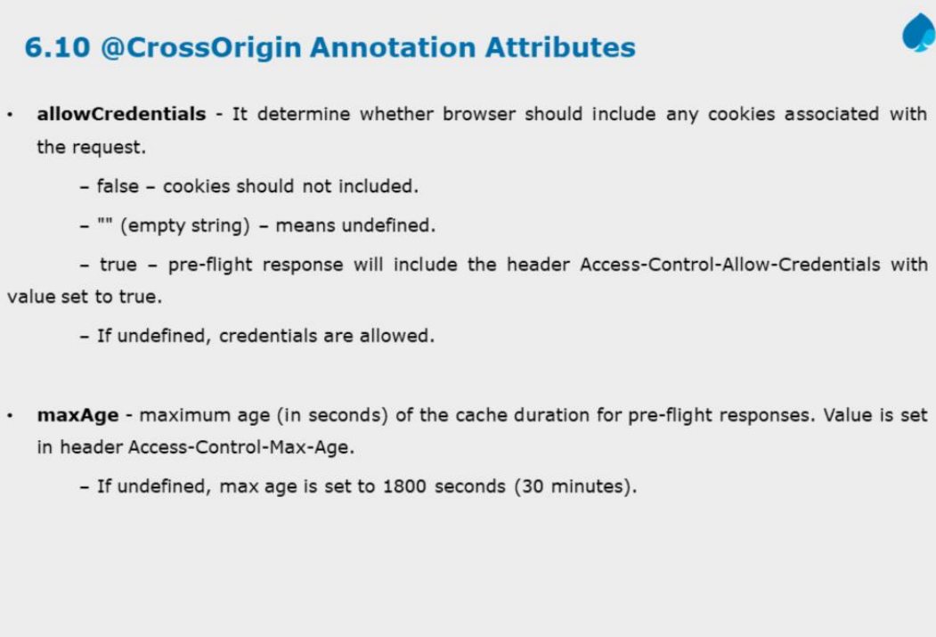

Slide 7
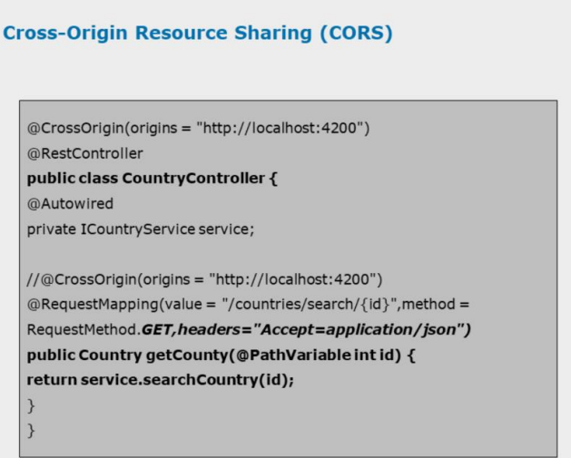

Slide 8
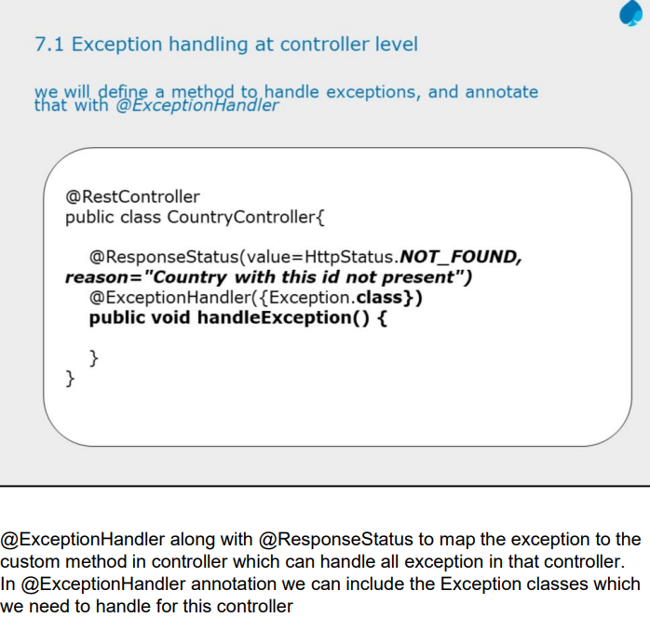

Slide 9
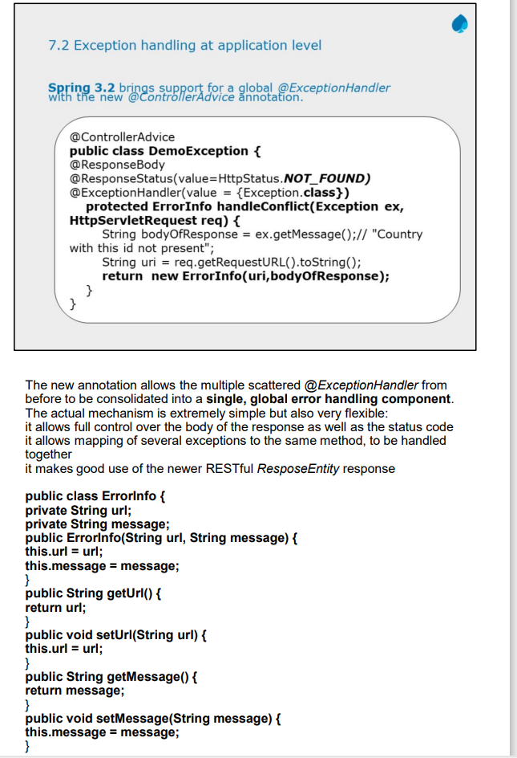

Slide 10
@ExceptionHandler
@ExceptionHandler annotation
It handles exceptions by creating a method to catch specific exceptions and return a customized response, often within a @ControllerAdvice class for global handling.
@ControllerAdvice
can define an ExceptionHandler method for a custom MyCustomException that returns a tailored ErrorResponse object to the user, rather than a generic error.

Slide 11
Two ways to use @ExceptionHandler
Controller-level: When placed directly within a @Controller or @RestController class, the @ExceptionHandler method will only handle exceptions for that specific controller.
This is useful for handling exceptions specific to a particular set of endpoints.
Global-level: By placing the @ExceptionHandler method inside a class annotated with @ControllerAdvice, you can centralize exception handling for all controllers in your application.
This is the recommended approach for providing a consistent error-handling strategy across your entire application.

Slide 12
@ExceptionHandler example with @ControllerAdvice
The most common and effective pattern is to combine @ExceptionHandler with @ControllerAdvice for global error handling.
1. Define custom exceptions
Create a custom exception for a specific business rule, such as when a requested resource is not found.
java
public class ResourceNotFoundException extends RuntimeException {
private static final long serialVersionUID = 1L;
public ResourceNotFoundException(String msg) {
super(msg);
}
}

Slide 13
ErrorMessage.java
public class ErrorMessage {
private int statusCode;
private String message;
public ErrorMessage(int statusCode, String message {
this.statusCode = statusCode;
this.message = message;
}
// getter, setter

Slide 14
global exception handler
2. Create a global exception handler
Create a class with the @ControllerAdvice annotation. This class will contain @ExceptionHandler methods to catch specific exceptions thrown from any controller.
The methods can then build a custom, user-friendly ResponseEntity.

Slide 15
Throw the exception from a controller
@ControllerAdvice
public class ControllerExceptionHandler {
@ExceptionHandler(ResourceNotFoundException.class)
public ResponseEntity<ErrorMessage> resourceNotFoundException(ResourceNotFoundException ex) {
ErrorMessage message = new ErrorMessage(
HttpStatus.NOT_FOUND.value(),
ex.getMessage());
return new ResponseEntity<ErrorMessage>(message, HttpStatus.NOT_FOUND);
}
@ExceptionHandler(Exception.class)
public ResponseEntity<ErrorMessage> globalExceptionHandler(Exception ex) {
ErrorMessage message = new ErrorMessage(
HttpStatus.INTERNAL_SERVER_ERROR.value(),
ex.getMessage());
return new ResponseEntity<ErrorMessage>(message, HttpStatus.INTERNAL_SERVER_ERROR);
}
}

Slide 16
In controller no need to handle using try and catch.
@RestController
@RequestMapping("/")
public class CustomerController {
@Autowired
private CustomerRepository customerRepository;
@GetMapping("/customer")
public ResponseEntity<List<Customer>> getAll() {
if (customerRepository.findAll().isEmpty()) {
// return new ResponseEntity<>(HttpStatus.NO_CONTENT);
throw new ResourceNotFoundException("list is empty");
} else
return new ResponseEntity<>(customerRepository.findAll(), HttpStatus.OK);
}
@PostMapping("/customer")
public ResponseEntity<Customer> addCustomer(@RequestBody Customer customer) {
return new ResponseEntity<Customer>(customerRepository.save(customer), HttpStatus.FOUND);
}
@PutMapping("/customer")
public ResponseEntity<Customer> updateCustomer(@RequestBody Customer customer) {
Customer c = customerRepository.findById(customer.getId()).orElseThrow(() -> new ResourceNotFoundException("no customer found with id " +customer.getId()));
return new ResponseEntity<>(customerRepository.save(customer), HttpStatus.FOUND);
}
@GetMapping("/customer/{id}")
public Customer searchCustomerById(@PathVariable Integer id){
public ResponseEntity<Customer> searchCustomerById(@PathVariable Integer id) {
Customer c = customerRepository.findById(id).orElseThrow(() -> new ResourceNotFoundException("no customer found with id " + id));
return new ResponseEntity<>(c, HttpStatus.OK);
}
@DeleteMapping("/customer/{id}")
public ResponseEntity<Customer> deleteCustomerByid(@PathVariable("id") int id) {
Customer c = customerRepository.findById(id).orElseThrow(() -> new ResourceNotFoundException("no customer found with id " + id));
customerRepository.deleteById(id);
return new ResponseEntity<>(c, HttpStatus.OK);
}
}

